Slide 1
AI-Based Fraud Detection System for online Proctored Exam

Slide 2
Outline
Introduction & Problem Statement
Objectives of the System
Scope & Assumptions
Proposed Solution Overview
System Architecture
Data Collection & Dataset Description
Cheating Detection Models
Tentative Project Timeline
Potential Bottlenecks, Challenges & System Limitations
Conclusion & Future Work

Slide 3




Introduction and problem statement
Growth of online exams and remote assessments
Limitations of human proctoring (costly, non-scalable, biased)
Common cheating behaviors:
Looking away from screen repeatedly
Multiple faces in frame
Suspicious eye movement patterns
Detected Mobile

Slide 4
Objectives of the System
Secondary Goals:
Compare XGBoost vs alternatives
Temporal behavior analysis
Automated report generation
Admin dashboard creation
Primary Goals:
Develop ML model with >90% accuracy
Real-time processing (25 FPS, <500ms latency)
Production-ready deployment (100+ concurrent)
Ensure fairness & GDPR compliance

Slide 5
Scope & Assumptions
What DOES Work: ✅ Face/hand detection ✅ Gaze tracking ✅ Phone detection ✅ Real-time alerts ✅ PDF reports
What DOESN'T Work: ❌ Answer authenticity verification ❌ Plagiarism detection ❌ Deep psychological reasoning
Key Assumptions:
Good webcam (720p+)
Adequate lighting (>50 lux)
Stable internet (>2 Mbps)
Cooperative student
Single camera view

Slide 6
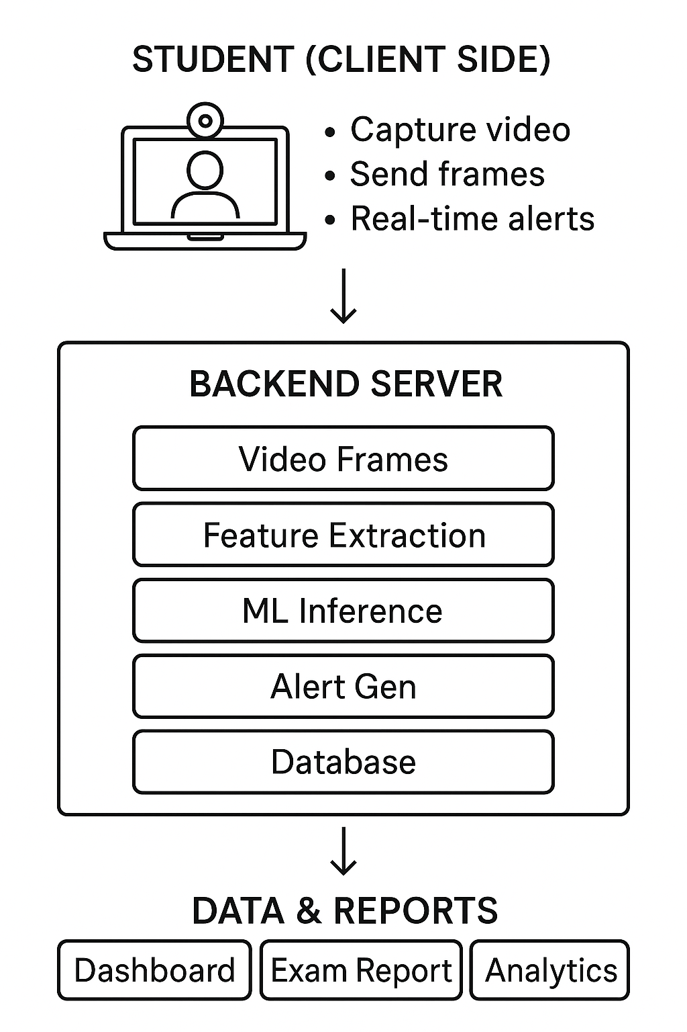
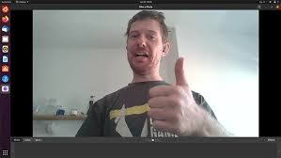

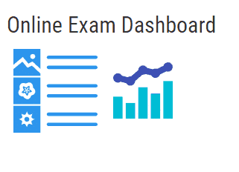
Proposed Solution Overview

Slide 7
Data Collection & Dataset Description
Students suspicious behaviors detection dataset for AI-powered online exam proctoring
Total Records: 5,500
Features/Record: 38
Cheating: 2,619 (47.6%)
Normal: 2,881 (52.4%)
Collection Method: Controlled SimVideo
Resolution: 720p @ 25 FPS
Annotation: 3 reviewers per frame
38 Features Breakdown:
Face Detection: 6 features
Hand Tracking: 8 features
Head Pose: 3 features
Gaze Tracking: 6 features
Phone Detection: 5 features
Body Posture: 2 features
Temporal: 2 features

Slide 8

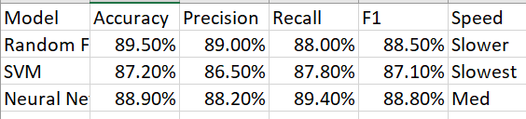
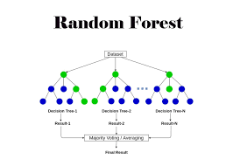
Cheating Detection Models
Existed models
Proposed Model
XGBoost: Maximum performance models.

Slide 9
Tentative Project Timeline
Tools & environment - 1 day
Project design & rules - 2 days
Dataset preparation - 2-3 weeks
Model Prototype– 10 days
Cheating rule engine & scoring - 2 days
UI & Integration - 3 days
Testing & evaluation - 4 days
Documentation, report & presentation - 1 week

Slide 10
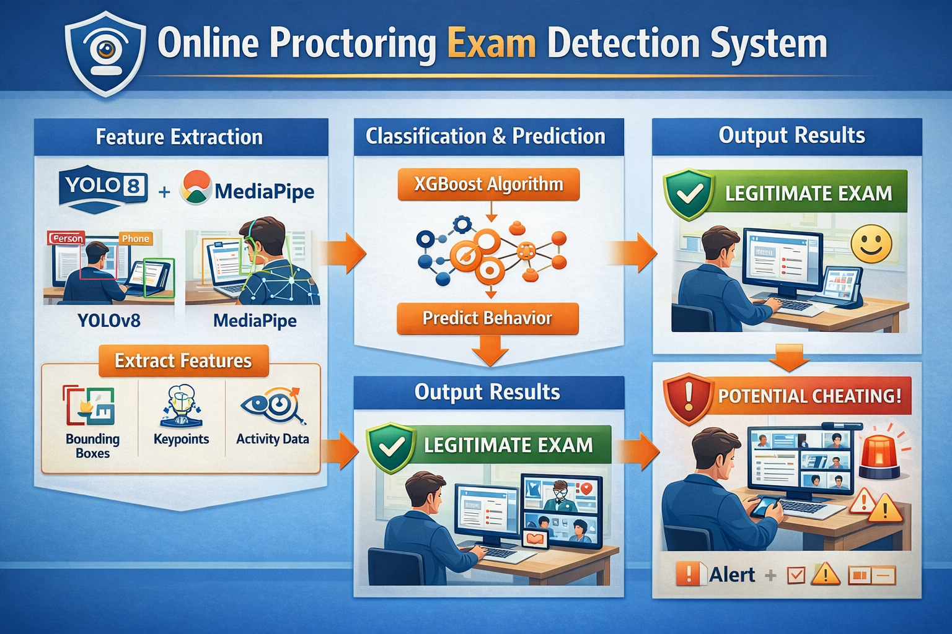
Pipeline

Slide 11
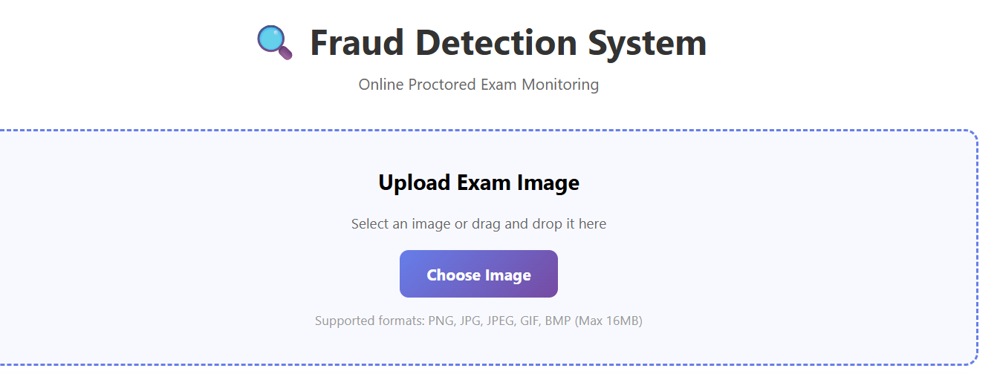
WorK Status

Slide 12
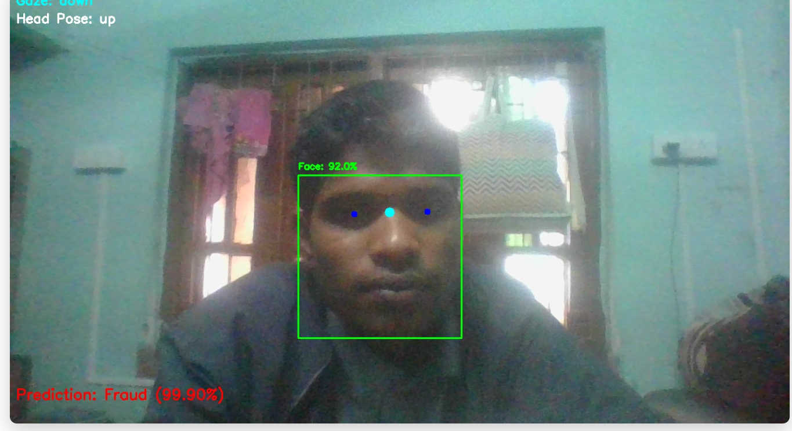
Work Status

Slide 13
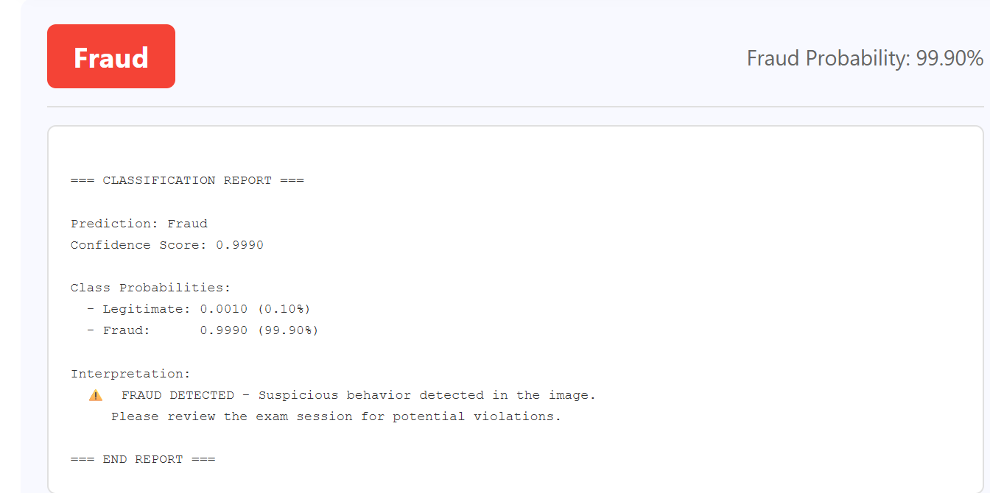
Output results

Slide 14
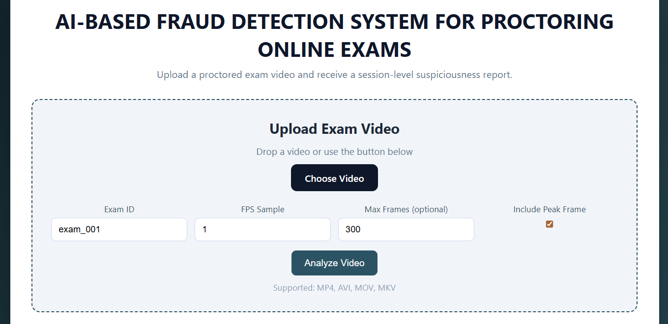
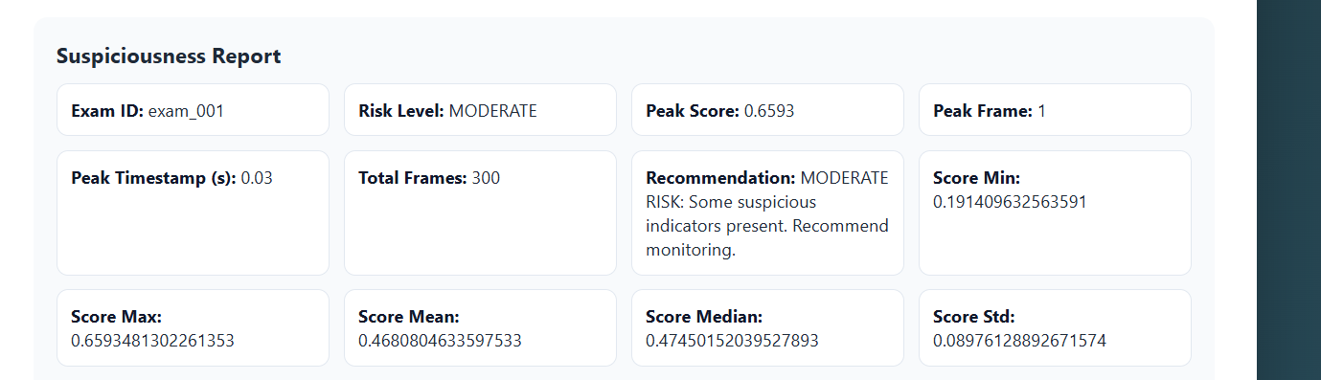
Current Status

Slide 15
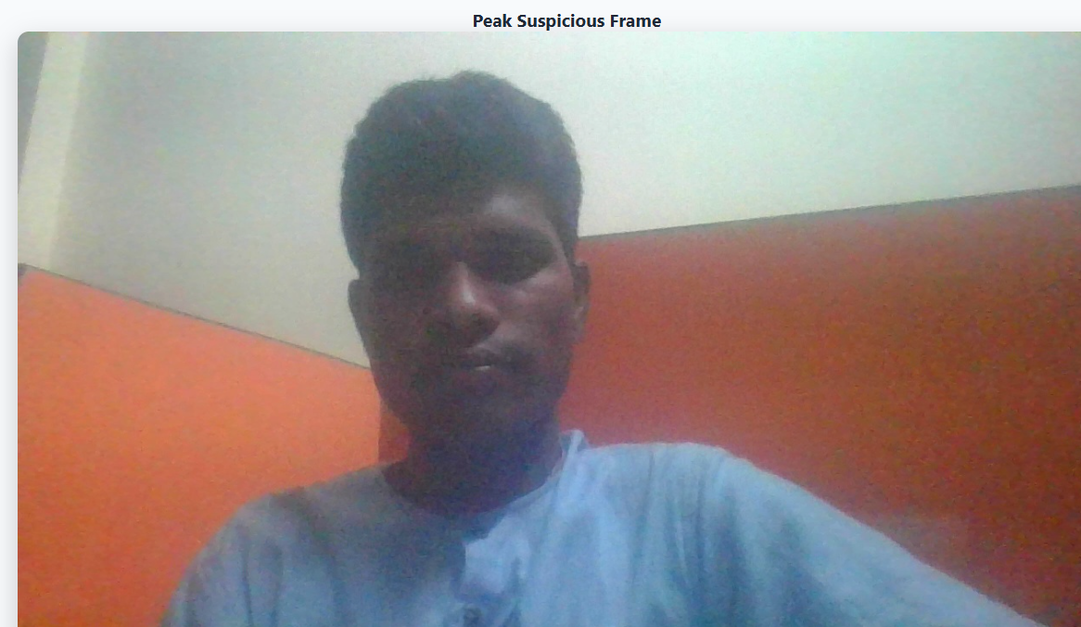

Slide 16
Issues and Leftover tasks
Need to Resolve the issue with the mediapipe feature extraction module
Need to add the model explainability module
Dataset creation– most tedious task
Resolve the issues with the model end to end video input pipeline.

Slide 17
Potential Bottlenecks, Challenges & System Limitations
Need diverse and Large Datasets: Need to add even more noise
Add LSTM models
No Audio Detection Module.

Slide 18
Conclusion & Future Work
This approach integrates the face detection, eye gaze and mobile presence.
Future extensions:
Audio-based cheating detection
Multi-Modal fraud detection

